Slide 1


Certificate in
STEM Curriculum Development Programme
5th run
Contact person: A/P Teo Tang Wee
tangwee.teo@nie.edu.sg
© 2022 Nanyang Technological University, Singapore. All Rights Reserved.

Slide 2
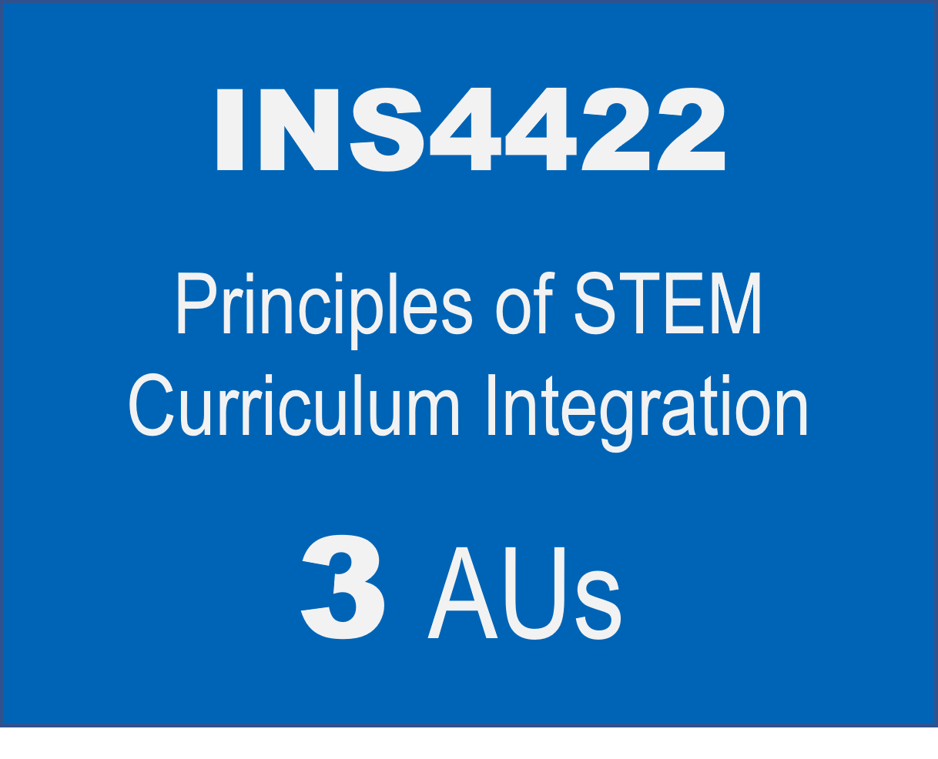
Structure
Certificate in
STEM Curriculum Development Programme
INS4423
INS4424
Approaches and Emerging Technologies in STEM Education
Designing an integrated STEM Education Portfolio
1
AUs
4
AUs
8 AUs

Slide 3
INS4422 Course Content
Module | Module Title | Online Asynchronous Week Beginning | Online Synchronous Week Beginning
1 | Origins of STEM Education | 14 April 2027 | 07 April 2027
2 | Successful STEM Education | 21 April 2027 | 28 April 2027
3 | STEM Education in Asia | 05 May 2027 | 12 May 2027
4 | The role of Science in STEM Education | 19 May 2027 | 26 May 2027
5 | Integrated STEM Framework | 02 June 2027 | 09 June 2027
6 | MOE STEM Education for Singapore | 16 June 2027 | 30 June 2027
7 | Consolidation |  | 07 July 2027
 |  | 18 hours | 21 hours
Once a week and 3h per session. Dates are subjected to change in discussion with the course participants.

Slide 4
INS4423 Course Content
No. | Topic | Dates | Format
1 | Digital coding to create aesthetic designs | 21 Jul 2027 | Face-to-Face @NIE, 3-6pm;
2 | Digital coding to create aesthetic designs | 28 Jul 2027 | Face-to-Face @NIE, 3-6pm;
3 | Digital literacies – Halocode | 04 Aug 2027 | Face-to-Face @NIE, 3-6pm; 1h HW
4 | Digital literacies – Halocode | 11 Aug 2027 | Face-to-Face @NIE, 3-6pm; 2h HW
5 | Digital literacies – Halocode | 18 Aug 2027 | Face-to-Face @NIE, 3-6pm;
6 | 3D software modeling to 3D printing | 25 Aug 2027 | Face-to-Face @NIE, 3-6pm;
7 | 3D software modeling to 3D printing | 01 Sep 2027 | Face-to-Face @NIE, 3-6pm;
8 | Asynchronous (self-paced learning) | 08 Sep 2027 | Asynchronous
9 | Visual AI to 3D printing | 15 Sep 2027 | Face-to-Face @NTU, 3-6pm
10 | Emerging Technologies for Food Science | 22 Sep 2027 | Face-to-Face @NTU, 3-6pm
11 | Emerging Technologies for Food Science | 29 Sep 2027 | Face-to-Face @NTU, 3-6pm
12 | Sustainability and Urban farming | 06 Oct 2027 | Face-to-Face @NIE, 3-6pm
13 | Sustainability and Urban farming | 13 Oct 2027 | Face-to-Face @NIE, 3-6pm
14 | Make Our School Sustainable: STEM Activities Incorporating Emerging Technologies | 20 Oct 2027 | Face-to-Face @NIE, 3-6pm
15 | Generative AI-integrated Science Demonstrations | 27 Oct 2027 | Face-to-Face @NIE, 3-6pm
16 | AI-empowered item generation, scoring, and feedback for STEM education | 03 Nov 2027 | Face-to-Face @NIE, 3-6pm
17 | AI-empowered image generation and analysis for STEM education | 10 Nov 2027 | Face-to-Face @NIE, 3-6pm
Topics and order are subjected to change

Slide 5
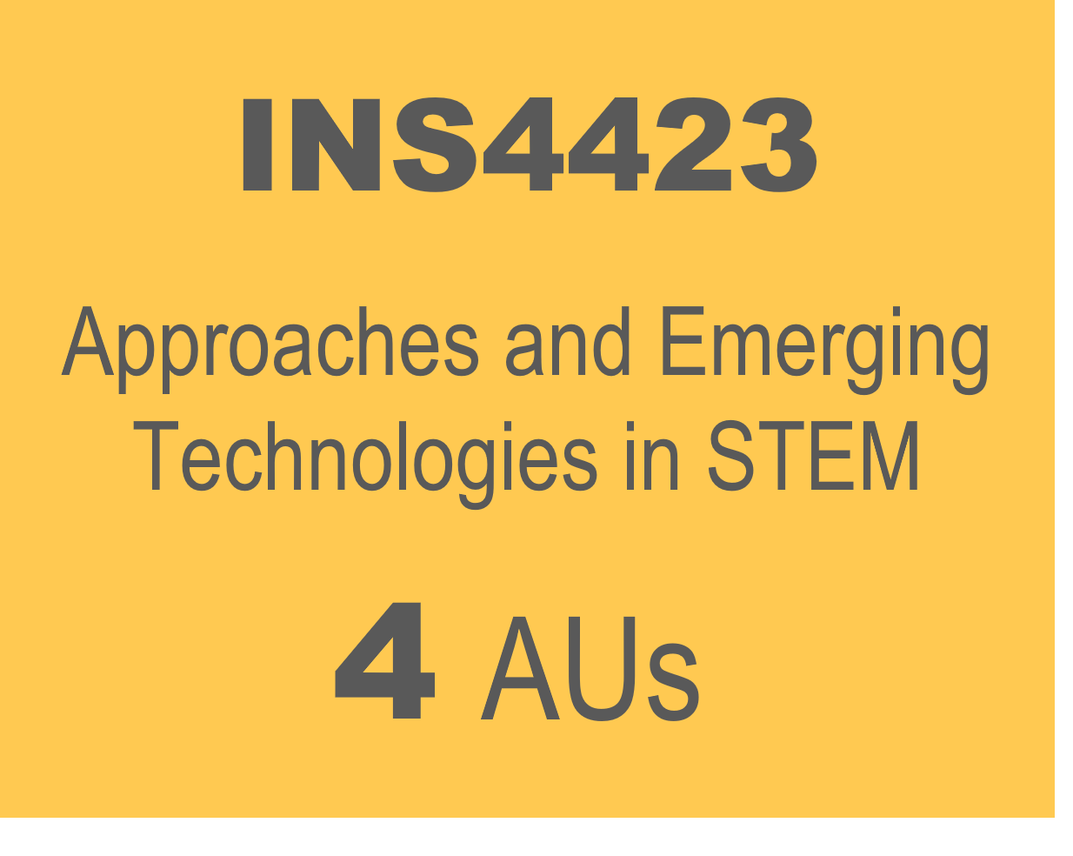
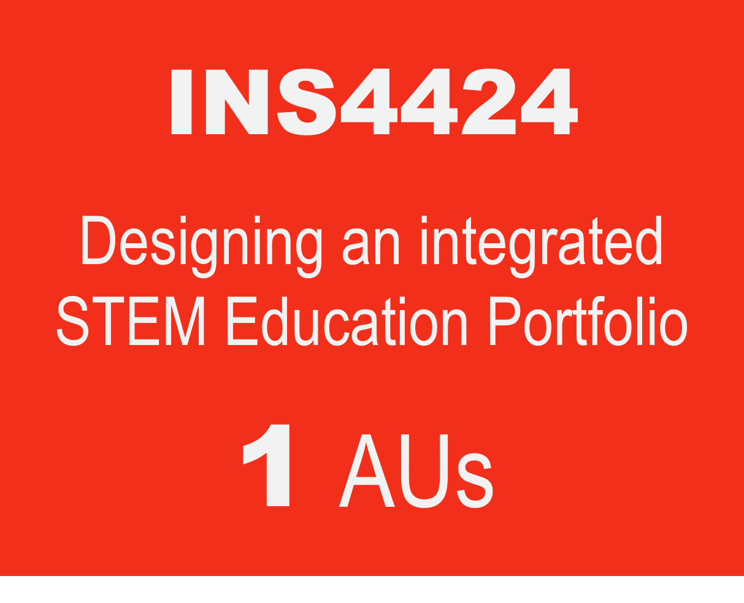
Illustration of Completion within 11 months
Year 2027
Year 2028
Q1 – Q2
Q3 – Q4
Q1 – Q2
Q3 – Q4
Apr - Jul
This 39h is 100% online. The content will be made available from April-Jul 2026
Jul - Nov
Jan - Feb
Q1: Jan-Mar; Q2: Apr-Jun; Q3: Jul-Sep; Q4: Oct-Dec

Slide 6
Entry Requirements
MOE Schools
Non-MOE Schools
Current STEM-related subject teachers (namely, Sciences, Mathematics, Computing, Design & Technology, Nutrition and Food Science);
Teachers with minimum two years in service; and
Letter of nomination from their school leaders
Current STEM-related subject teachers (namely, Sciences, Mathematics, Computing, Design & Technology, Nutrition and Food Science); and
Minimum two years of STEM education (e.g., curriculum design, teaching, etc.) experience.
Letter of support from their employers/school leaders
Notes:
The entry requirements for each group are stated below:
For MOE schools with/ without STEM Applied Learning Programmes (ALP):
Current STEM-related subject teachers (namely, Sciences, Mathematics, Computing, Design & Technology, Nutrition and Food Science);
Teachers with minimum two years in service; and
Letter of nomination from their school leaders
2. For non-MOE schools:
Current STEM-related subject teachers (namely, Sciences, Mathematics, Computing, Design & Technology, Nutrition and Food Science); and
Minimum two years of STEM education (e.g., curriculum design, teaching, etc.) experience.
Letter of support from their employers/school leaders

Slide 7
Programme Fees
*MOE Participant | Non-MOE Participant
$1,300 | $5,980
Fees are subjected to copyright fee and GST.
*MOE Participant may be eligible for funding by the Ministry of Education (MOE).

Slide 8

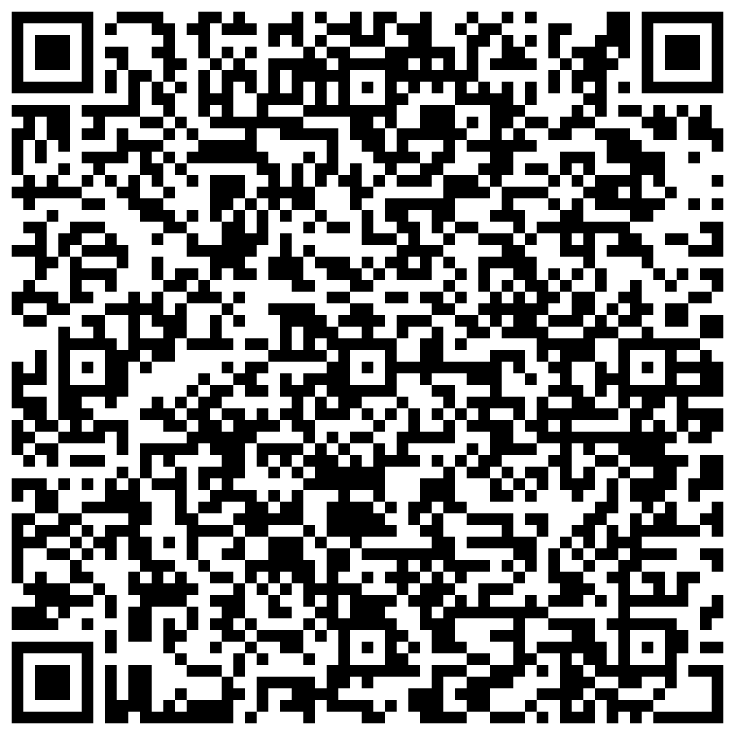

Application
Closing date: 12 Nov 2026
Please email your letter of nomination/support from your employers/school leaders to shafiqah.raihan@nie.edu.sg.

Slide 9
FAQ
Is the MOE sponsorship on first-come-first-serve basis?
  No, it isn’t. We will review the applications (including the write-up) in making the selection. We will also ensure equitable distribution of opportunities across schools.
My school is an autonomous/independent school. Am I eligible for the MOE sponsorship?
  The sponsorship is for MOE schools (including autonomous), HQ officers and AST officers. Alternative funding include school’s PD funds and self-funding.
If I register for this Programme, how do I attend lessons in the afternoons on weekdays?
  Alternative arrangements will have to be made at the school level. The Principals’ letter of support as indication of commitment to the teacher’s PD growth is important in this context.

Slide 10
FAQ
4. What happens if the sponsored teacher cannot cope halfway and ask to withdraw from the course? Will there be any penalty?
5. What is the penalty for me if I am sponsored by MOE and cannot complete the programme?
  Cases of teachers being unable to complete certification courses would likely be rare as these teachers would have made a commitment and sought support from their school before embarking on the certification.
  If there are such cases, MOE will review on a case-by-case basis (ideally in their 4th year for sufficient lead time for engagement).
The teacher has attended >30% of the course duration | A “W” grade will be awarded. Required to pay full course fee.
The teacher has attended <30% of the course duration | A “W” grade will be awarded. Not required to pay full course fee.

Slide 11
FAQ
5. Can I take the courses as stand-a-long in service course?
  Yes. However, we have a quota of 30pax for each cycle. Registration for inservice is open after we have confirmed the Programme participants.
6. What if I am not sure if I can commit to completing the Programme?
  Consider taking the courses as stand-a-lone course and stack them toward a Certification programme within 5 years.

Slide 12
Certificate in
STEM Curriculum Development Programme
© 2022 Nanyang Technological University, Singapore. All Rights Reserved.

