Slide 1
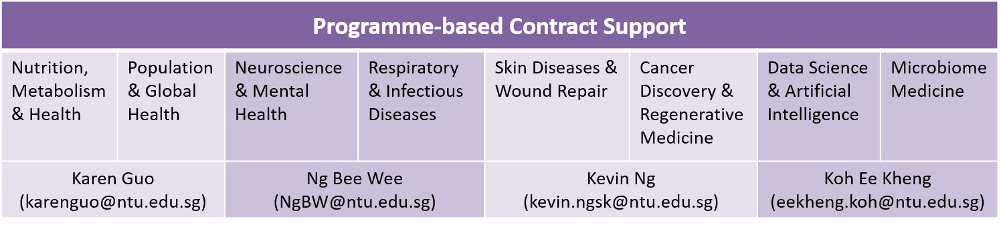
Research Agreement Review Process
Overseen by the LKC Contract Management Team
Before submitting through Legal Services LSOnline 2.0 (Lexagle) via NTU ServiceNow platform , please drop us the details of the agreement for your request as according to the POC (see table below) for your programme
Negotiate Agreement Clauses with all parties
(For Industry Agreements, LKC Industry Risk Assessment is required)
LKC PI
via Lexagle
Review of Agreement by LSO and any further review as required by NTUitive or other NTU departments
Verifications by LKC Finance/Research Support Office (if involving a grant)/ RASS Operations for Finance and Operational details in the agreement.
PI Confirmation, CA Confirmation, Initiate DOA and DOA Approval according to NTU/LKC Delegation Of Authority (DOA)
Signing of agreement by the relevant authority according to NTU/LKC DOA
Finalize Agreement between external parties and LSO

Slide 2
DRCS Research Agreement Review Process
Overseen by the LKC Contract Management Team
Negotiate Agreement Clauses with all parties
(For Industry Agreements, LKC Industry Risk Assessment is required)
LKC PI (using DRCS dataset or manpower)
DRCS Director’s Endorsement
Review of Agreement by LSO and any further review as required by NTUitive or other NTU departments
Email DRCS contracts POC (Bee Wee) the details of the agreement
via Lexagle
Verifications by LKC Finance/Research Support Office (if involving a grant)/ RASS Operations for Finance and Operational details in the agreement.
PI Confirmation, CA Confirmation, Initiate DOA and DOA Approval according to NTU/LKC Delegation Of Authority (DOA)
Signing of agreement by the relevant authority according to NTU/LKC DOA
Finalize Agreement between external parties and LSO

Slide 3
Programme-based Contract Support
Nutrition, Metabolism & Health | Population & Global Health | Neuroscience & Mental Health | Respiratory & Infectious Diseases | Skin Diseases & Wound Repair | Cancer Discovery & Regenerative Medicine | Data Science & Artificial Intelligence | Microbiome Medicine
Karen Guo (karenguo@ntu.edu.sg) |  | Ng Bee Wee (NgBW@ntu.edu.sg) |  | Kevin Ng (kevin.ngsk@ ntu.edu.sg) | Jolene Ong (jolene.ongzt@ntu.edu.sg)

