Slide 1
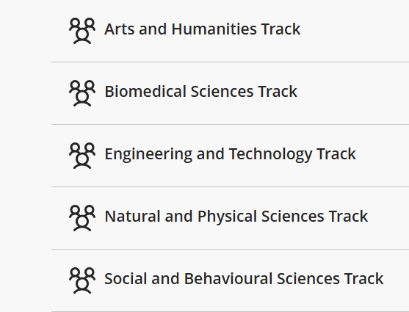
GP8003 (formerly ERWA01) Workflow for AY26/27 Sem 1
Postgrad research students automatically enrolled in GP8003
11 Aug 2026
GP8003 course site opens on NTULEARN
Students sign up for
one course track
based on School / Supervisor recommendation
Students complete exam pre-requisites by 23 Oct 2026
10 – 11 Nov 2026
Online Final Exam
Course Code : 26S1-GP8003
Course Title : EPIGEUM RESEARCH INTEGRITY COURSE
Course Track Options under GP8003
Examination Details
Date: | 10 – 11 Nov 2026 (Final examination components will be available on GP8003 course site from 10 Nov 2.00pm – 11 Nov 2.00pm)
Format: | Online examination
Passing requirements: | Standard Course Quiz (16 questions) – Minimum passing score is 13 Track Specific Quiz (16 questions) – Minimum passing score is 13 Course Evaluation Survey – All survey questions must be answered. *Failure to meet the passing requirements will result in a 'Fail' grade on your transcript, and you will be required to retake the course in the following semester.
See subject areas covered by each track
Resources:
Course Access Guide
FAQs page – includes information on Exam Pre-requisites and Trial Quizzes
Note: PGR students are required to complete ERWA02 (a shorter refresher course) in Year 3.
Have Questions? Email us at rieo@ntu.edu.sg

