Slide 1
Certificate in STEM Curriculum Development Programme
3rd run
Contact person: A/P Teo Tang Wee
tangwee.teo@nie.edu.sg
© 2022 Nanyang Technological University, Singapore. All Rights Reserved.
© 2022 Nanyang Technological University, Singapore. All Rights Reserved.

Slide 2
Structure
Certificate in STEM Curriculum Development Programme
INS4423
INS4424
Approaches and Emerging Technologies in STEM Education
Designing an integrated STEM Education Portfolio
1
AUs
4
AUs
8 AUs
© 2022 Nanyang Technological University, Singapore. All Rights Reserved.

Slide 3
INS4422 Course Content
Module | Module Title | Online Asynchronous Week Beginning | Online Synchronous Week Beginning
1 | Origins of STEM Education | 9 April 2025 | 2 April 2025
2 | Successful STEM Education | 16 April 2025 | 23 April 2025
3 | STEM Education in Asia | 30 April 2025 | 7 May 2025
4 | The role of Science in STEM Education | 14 May 2025 | 21 May 2025
5 | Integrated STEM Framework | 28 May 2025 | 4 June 2025
6 | MOE STEM Education for Singapore | 11 June 2025 | 25 June 2025
7 | Consolidation |  | 2 Jul 2025
 |  | 18 hours | 21 hours
Once a week and 3h per session. Dates are subjected to change in discussion with the course participants.
© 2022 Nanyang Technological University, Singapore. All Rights Reserved.

Slide 4
INS4423 Course Content
No. | Topic | Dates | Format
1 | Introduction to Emerging Technologies in STEM and its applications | 23 July 2025 | Face-to-face @M38, 3-6pm
 | Digital coding to create aesthetic designs
2 | Digital coding to create aesthetic designs | 30 Jul 2025 | Face-to-face @M38, 3-6pm
3 | Digital literacies - Halocode | 6 Aug 2025 | Face-to-Face @NIE, 3-6pm; 1h HW
4 |  | 13 Aug 2025 | Face-to-Face @NIE, 3-6pm; 1h HW
 |  | 210Aug 2025 | Face-to-Face @NIE, 3-6pm; 1h HW
4 |  | 21 Aug 2024 | Face-to-Face @NIE, 3-6pm; 1h HW
5 | Cognitive processes in STEM inquiry- Computational thinking | 27 Aug 2025 | Face-to-Face @NIE, 3-6pm
6 |  | 3 Sept 2025 | Face-to-Face @NIE, 3-6pm
7 | Sustainability - 3D printing | 10 Sept 2025 | Face-to-Face @NTU, 3-6pm
8 | Sustainability - 3D printing | 17 Sept 2025 | Face-to-Face @NTU, 3-6pm
9 | Sustainability - 3D printing | 24 Sept 2025 | Face-to-Face @NTU, 3-6pm
10 | Sustainability and Urban farming | 1 Oct 2025 | Face-to-Face @NIE, 3-6pm
11 | Sustainability and Urban farming | 8 Oct 2025 | Face-to-Face @NIE, 3-6pm
12 | Sustainability and Urban farming | 15 Oct 2025 | Face-to-Face @NIE, 3-6pm
13 | Generative AI | 22 Oct 2025 | Face-to-Face @NIE, 3-6pm
14 | Generative AI | 29 Oct 2025 | Face-to-Face @NIE, 3-6pm
15 | Science Centre Visit | 5 Nov 2025 | Face-to-Face @NIE, 3-6pm
16 | Self-learning: Entrepreneur thinking, engineering thinking, design thinking | 12 Nov 2025 | Asynchronous
© 2022 Nanyang Technological University, Singapore. All Rights Reserved.

Slide 5
Illustration of Completion within 11 months
Year 2025
Year 2026
Q1 – Q2
Q3 – Q4
Q1 – Q2
Q3 – Q4
Apr - Jul
This 39h is 100% online. The content will be made available from April-Jul 2025
Jul - Nov
Jan - Feb
Q1: Jan-Mar; Q2: Apr-Jun; Q3: Jul-Sep; Q4: Oct-Dec
© 2022 Nanyang Technological University, Singapore. All Rights Reserved.

Slide 6
Entry Requirements
MOE Schools
Non-MOE Schools
Current STEM-related subject teachers (namely, Sciences, Mathematics, Computing, Design & Technology, Nutrition and Food Science);
Teachers with minimum two years in service; and
Letter of nomination from their school leaders
Current STEM-related subject teachers (namely, Sciences, Mathematics, Computing, Design & Technology, Nutrition and Food Science); and
Minimum two years of STEM education (e.g., curriculum design, teaching, etc.) experience.
Letter of support from their employers/school leaders
© 2022 Nanyang Technological University, Singapore. All Rights Reserved.
Notes:
The entry requirements for each group are stated below:
For MOE schools with/ without STEM Applied Learning Programmes (ALP):
Current STEM-related subject teachers (namely, Sciences, Mathematics, Computing, Design & Technology, Nutrition and Food Science);
Teachers with minimum two years in service; and
Letter of nomination from their school leaders
2. For non-MOE schools:
Current STEM-related subject teachers (namely, Sciences, Mathematics, Computing, Design & Technology, Nutrition and Food Science); and
Minimum two years of STEM education (e.g., curriculum design, teaching, etc.) experience.
Letter of support from their employers/school leaders

Slide 7
Programme Fees
*MOE Participant | Non-MOE Participant
$1,300 | $5,980
Fees are subjected to copyright fee and GST.
*MOE Participant may be eligible for funding by the Ministry of Education (MOE).
© 2022 Nanyang Technological University, Singapore. All Rights Reserved.

Slide 8
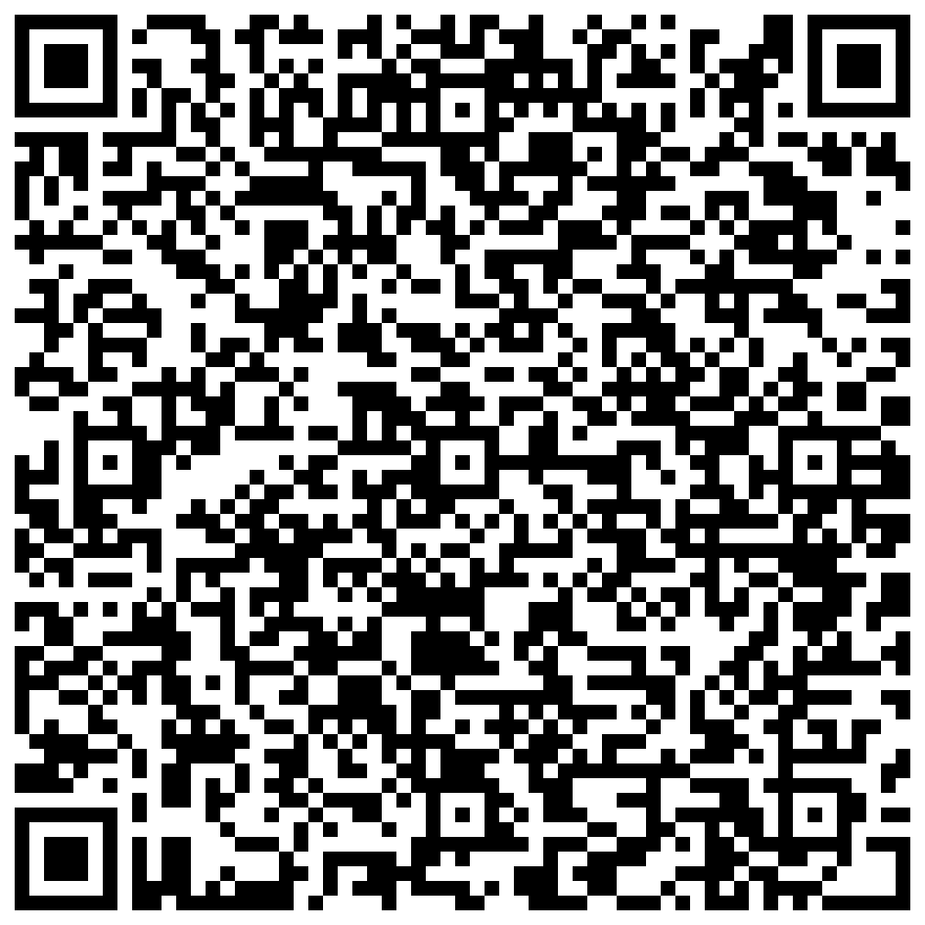
Application
Closing date: 12 Nov 2024
Please email your letter of nomination/support from your employers/school leaders to shafiqah.raihan@nie.edu.sg.
© 2022 Nanyang Technological University, Singapore. All Rights Reserved.

Slide 9
FAQ
Is the MOE sponsorship on first-come-first-serve basis?
No, it isn’t. We will review the applications (including the write-up) in making the selection. We will also ensure equitable distribution of opportunities across schools.
My school is an autonomous/independent school. Am I eligible for the MOE sponsorship?
The sponsorship is for MOE schools (including autonomous), HQ officers and AST officers. Alternative funding include school’s PD funds and self-funding.
If I register for this Programme, how do I attend lessons in the afternoons on weekdays?
Alternative arrangements will have to be made at the school level. The Principals’ letter of support as indication of commitment to the teacher’s PD growth is important in this context.
© 2022 Nanyang Technological University, Singapore. All Rights Reserved.

Slide 10
FAQ
4. What happens if the sponsored teacher cannot cope halfway and ask to withdraw from the course? Will there be any penalty?
5. What is the penalty for me if I am sponsored by MOE and cannot complete the programme?
Cases of teachers being unable to complete certification courses would likely be rare as these teachers would have made a commitment and sought support from their school before embarking on the certification.
If there are such cases, MOE will review on a case-by-case basis (ideally in their 4th year for sufficient lead time for engagement).
The teacher has attended >30% of the course duration | A “W” grade will be awarded. Required to pay full course fee.
The teacher has attended <30% of the course duration | A “W” grade will be awarded. Not required to pay full course fee.
© 2022 Nanyang Technological University, Singapore. All Rights Reserved.

Slide 11
FAQ
5. Can I take the courses as stand-a-long in service course?
Yes. However, we have a quota of 30pax for each cycle. Registration for inservice is open after we have confirmed the Programme participants.
6. What if I am not sure if I can commit to completing the Programme?
Consider taking the courses as stand-a-lone course and stack them toward a Certification programme within 5 years.
© 2022 Nanyang Technological University, Singapore. All Rights Reserved.

Slide 12
Certificate in STEM Curriculum Development Programme
© 2022 Nanyang Technological University, Singapore. All Rights Reserved.
© 2022 Nanyang Technological University, Singapore. All Rights Reserved.

